Slide 1

Predicting the energy output of wind turbine based on weather condition using IBM Cloud

Slide 2

Team:- EEE-007
Member 1
Name: R.Ruchitha
Roll No:-20R15A0230
Member 2
Name:- Uttej Chary
Roll No:-20R15A0235
Member 3
Name: M.Vinay
Roll No:-20R15A0236
Member 4
Name:-Naram Deepak Balaji
Roll No:-20R15A0239

Slide 3

Index
Aim
Project Introduction
Solution
Roadmap
How to build a project
Applications
Advantages and Disadvantages
Conclusion

Slide 4
INTRODUCTION
Wind energy plays an increasing role in the supply of energy world-wide.
The energy output of a wind farm is highly dependent on the wind conditions present at its site. If the output can be predicted more accurately, energy suppliers can coordinate the collaborative production of different energy sources more efficiently to avoid costly overproduction.

Slide 5

SOLUTION
We analyzed the data for a Windmill Farm and extracted the weather parameters that affect power generation the most.
Then we prepared an ML model taking the obtained features in consideration, using random forest regressor model.
Then for provinding solution quicker to the end-user, we made an web app to obtain power predictions

Slide 6

Road Map
2.Data
Collection
4.Model
Design
3.Data
Pre-processing
1.Work
Distribution
5.Application
Design

Slide 7
How to build the Project
Data Collection:-Collect the dataset or Create the dataset
Data Preprocessing:-Import the Libraries.Importing the dataset.Checking for Null Values.Data Visualization.Taking care of Missing Data.Label encoding.One Hot Encoding.Feature Scaling.Splitting Data into Train and test
Model Building:-Training and testing the modelEvaluation of Model
Application Building:-Create an HTML file.Build a Python script..

Slide 8

Data Collection
We used the wind turbine dataset named as T1.csv file from Flask Folder provided in the Gitub of the problem and downloaded the weather conditions data of the same place and of the same time from the web.

Slide 9

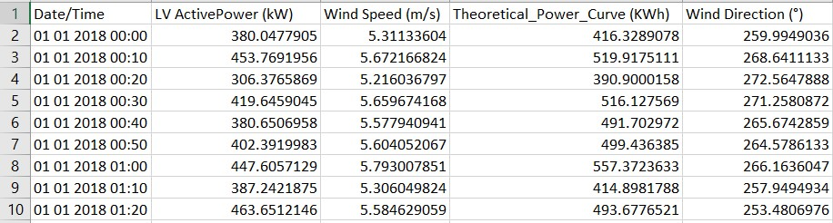
T1.csv data

Slide 10
Data pre-processing
Activity 1 : Taking care of the missing data
Solution - The missing data is less than 5% of the total data so we have filled the missing data by the average value of the respective column data.
Activity 2 : Feature scaling
Solution - Weather data has a scale of 30 minutes while the wind turbine data from Kaggle has a scale of 10 minutes so in order to merge both the data's we have converted each of them into the same scale (i.e. scale of 30 minutes). Then we merged both the data's into one and obtained our final data.

Slide 11

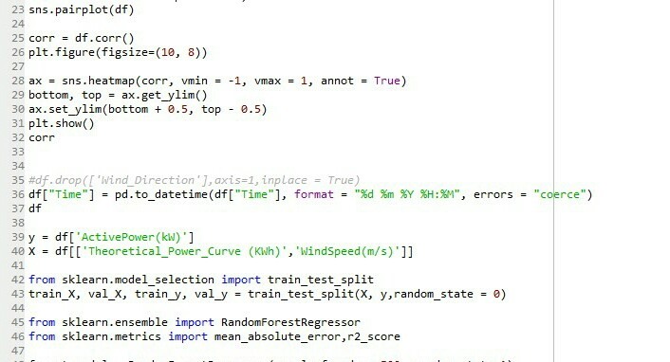
Code Screenshot

Slide 12
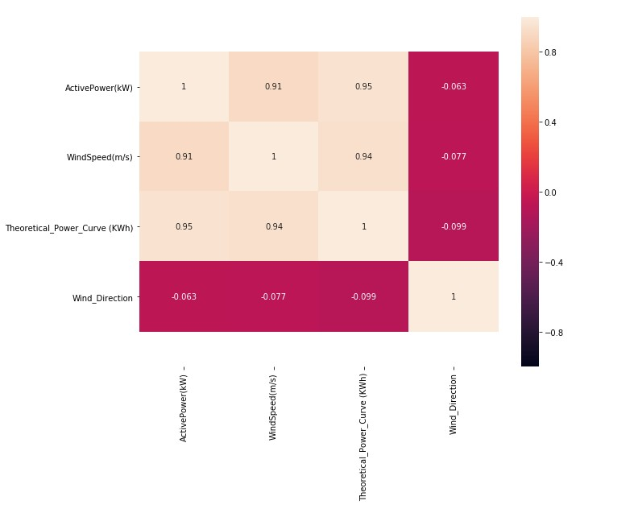
Screenshot

Slide 13

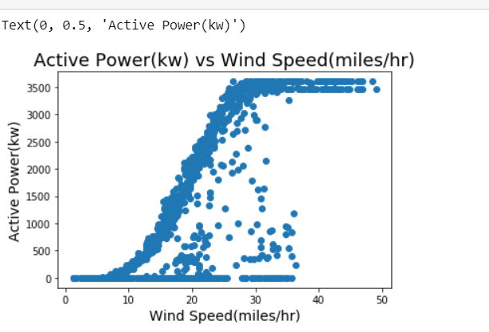
Activity 3: Visualization of the Data
Solution- We analyzed the data and studied the impact of different features on output (active power). With the results we achieved, we eradicated all the unnecessary features from the model

Slide 14
Model Design
Activity 1: Deciding parameters or features
Solution- With the results we achieved we have selected following as our features for the model :
1.Wind Speed
2.Temperature
3.Humidity
4.Pressure

Slide 15

Activity 2: Separating Training and Testing data from the data set Solution- This process will be done inside the model file itself by using the train_test_split library in the sklearn package of python.
Activity 3: Developing the model Solution- We use the random forest regressor model to train and evaluate the model

Slide 16
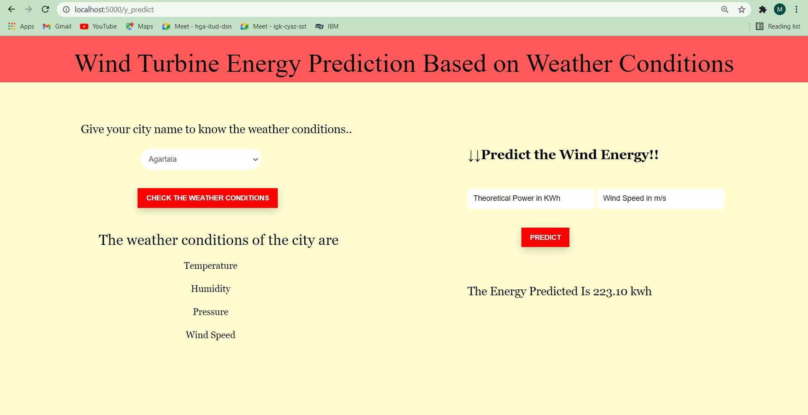
App interface

Slide 17

APPLICATIONS
Air Traffic
Marine
Agriculture
Utility companies
Private sectors
Military application

Slide 18

🔱Advantages and Disadvantages
ADVANTAGES
Accurate values
Reliability
Quick response
On giving location permission,any one can predict power output at your live location
It is more convenient to use in worldwide

Slide 19

DISADVANTAGES
Limited API requests per day.
Android App can't be deployed on IBM Cloud.
No free server available on IBM Cloud for deploying Backend.
Known can be used

Slide 20
Conclusion
In this project, we used Weather Underground services (subsidiary of IBM) to get accurate historical weather data. For merging this data with Windmill data we learned some Data Analysis concepts. We analyzed several ML models, and choose Random Forest Regressor to develop this model. We integrated the app with model Weather API and Flask Back-end. The accuracy of Random Forest Regressor model for this project is 90%.

Slide 21

THANK YOU

